Slide 2
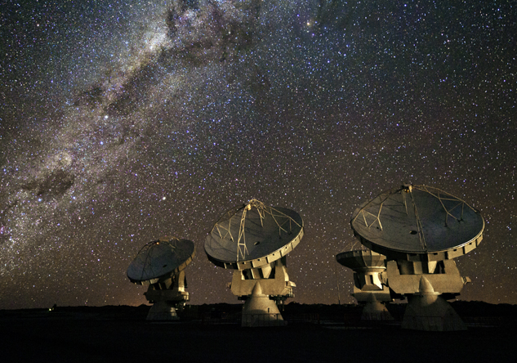
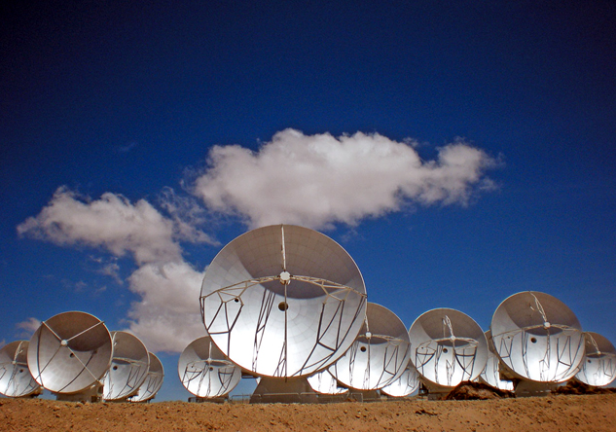
What is ALMA?
The Atacama Large Millimeter/submillimeter Array (ALMA) is a radio telescope made up of 66 antennas which can work together as a single antenna with a total diameter of 16 kilometers.
Although construction of the array will continue until late 2013, once finished ALMA will be the most powerful radio astronomy observatory in human history.
Through greatly increased resolution power ALMA will be able to make astronomical observations beyond the known Universe.
Artist's conception of ALMA array.
Credit: ALMA (ESO/NAOJ/NRAO).
Array of 4 antennas with the Milky Way in the background, Chajnantor Plateau, Atacama Desert, 2010.
Credit: ALMA (ESO/NAOJ/NRAO), J.F.Salgado.
Array of 13 antennas, Chajnantor Plateau, Atacama Desert.
Credit: ESO.
Notes:
What is ALMA?
The Atacama Large Millimeter/submillimeter Array (ALMA) is a radio telescope made up of 66 antennas which can work together as a single antenna with a total diameter of 16 kilometers.
Although construction of the array will continue until late 2013, once finished ALMA will be the most powerful radio astronomy observatory in human history.
Through greatly increased resolution power ALMA will be able to make astronomical observations beyond the known Universe

Slide 3
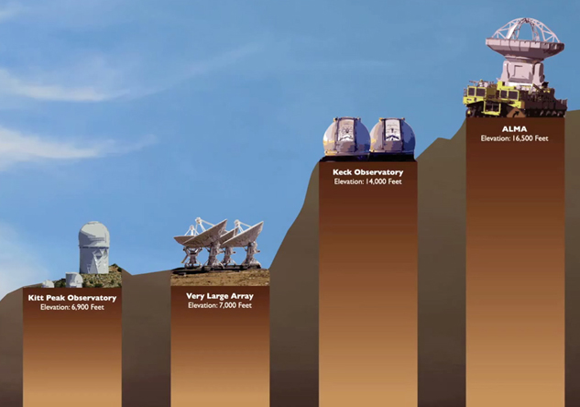
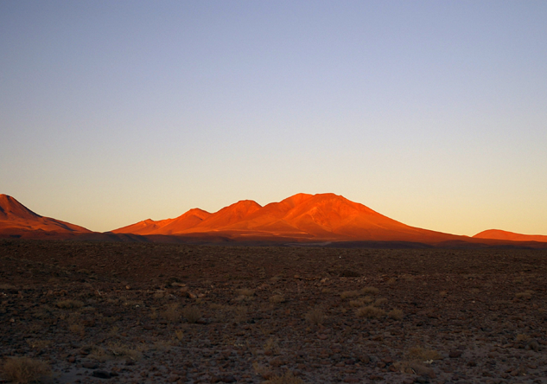
Why is ALMA so powerful?
Because it is located 5,000 meters above sea level on the Chajnantor Plateau in the Atacama Desert.
The altitude and aridity make it an exceptional site for astronomical observation.
The minimal amount of water vapor at the site provides the transparency needed for the antennas to capture millimetric radio wavelengths without distortion.
Map of ALMA locations.
Credit: NAOJ.
Sunset at the Chajnantor Plateau, 2008.
Credit: ALMA (ESO/NAOJ/NRAO).
ALMA is the highest-altitude land-based observatory.
Credit: ALMA (ESO/NAOJ/NRAO).
Notes:
Why is ALMA so powerful?
Because it is located 5,000 meters above sea level on the Chajnantor Plateau in the Atacama Desert.
The altitude and aridity make it an exceptional site for astronomical observation.
The minimal amount of water vapor at the site provides the transparency needed for the antennas to capture millimetric radio wavelengths without distortion.

Slide 4
Why is ALMA so powerful?
This is due to the quantity and quality of its antennas, covering a surface of 6,500 square meters, equivalent to a soccer field.
33 antennas on the Chajnantor Plateau, 2012.
Credit: ALMA (ESO/NAOJ/NRAO), J. Guarda (ALMA).
14 antennas on the Chajnantor Plateau, 2011.
Credit: ALMA (ESO/NAOJ/NRAO), J. Guarda (ALMA).
6 antennas on the Chajnantor Plateau, 2010.
Credit: ALMA (ESO/NAOJ/NRAO), J. Guarda (ALMA).
Notes:
Why is ALMA so powerful?
This is due to the quantity and quality of its antennas, covering a surface of 6,500 square meters, equivalent to a soccer field.
NOTE: The ALMA radio telescope will consist of 54 antennas, each with a diameter of 12 meters, and 12 antennas with a diameter of 7 meters.

Slide 5
Why is ALMA so powerful?
Because of its technology, which includes a unique system of perfectly synchronized data collection, processing and storage.
ALMA antenna component, 2008.
Credit: ALMA (ESO/NAOJ/NRAO), NAOJ.
Notes:
Why is ALMA so powerful?
Because of its technology, which includes a unique system of perfectly synchronized data collection, processing and storage.

Slide 6
Why is ALMA so powerful?
Because it is an astronomical observatory that brings together high-level scientists, engineers and professionals from around the world.
JAO Team at ALMA, 2011.
Credit: ALMA (ESO/NAOJ/NRAO).
Review panel, 2009.
Credit: ALMA (ESO/NAOJ/NRAO).
AIV team, 2009.
Credit: ALMA (ESO/NAOJ/NRAO).
ALMA team.
Credit: ALMA (ESO/NAOJ/NRAO).
Safety team, 2006.
Credit: ALMA (ESO/NAOJ/NRAO).
Notes:
Why is ALMA so powerful?
Because it is an astronomical observatory that brings together high-level scientists, engineers and professionals from around the world.

Slide 7
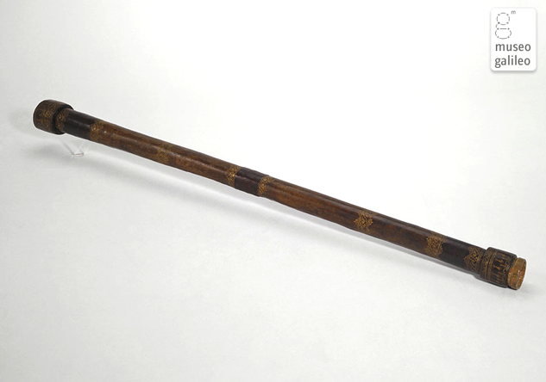
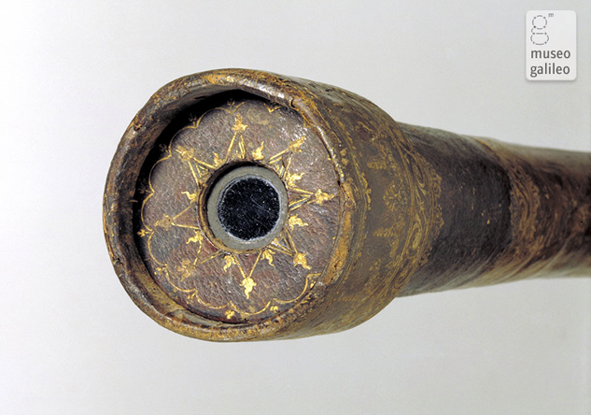
Astronomy: The First Observations
All civilizations have observed the Universe, trying to uncover not only its origins and the nature of things around us, but also our place within it.
Initially, these observations involved studying the movement of heavenly bodies with the human eye.
It wasn’t until the 17th Century when Italian scientist Galileo Galilei first directed his optical telescope to the night sky that the study of an unknown universe began.
Nebra's sky disk. First known representation of the sky, dating from the Iron Age.
Credit: Dbachmann. License: GNU.
Galilei´s optical telescope, 17th century.
Credit: Galileo Museum, Florence. Photo by Franca Principe.
Notes:
Astronomy: The First Observations
All civilizations have observed the Universe, trying to uncover not only its origins and the nature of things around us, but also our place within it.
Initially, these observations involved studying the movement of heavenly bodies with the human eye.
It wasn’t until the 17th Century when Italian scientist Galileo Galilei first directed his optical telescope to the night sky that the study of an unknown universe began.
NOTE: Galileo’s telescopes enhanced the size of known objects from 6 to 9 times. Among Galileo’s first discoveries were the irregularities of the lunar surface, which he called “lunar mountains”, as well as four of Jupiter’s moons.

Slide 8
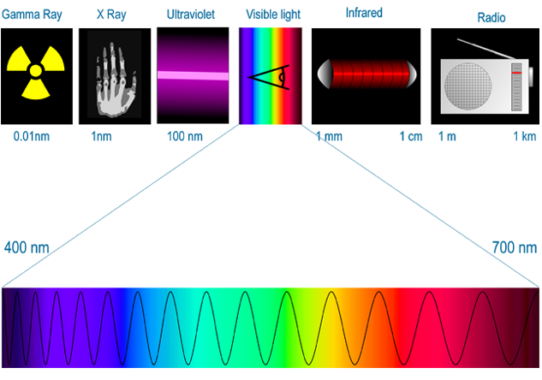
Light in the Universe
Today we know that matter in the Universe emits light in various wavelengths;
Visible light observed through optical telescopes for over 400 years, which is reflected by hot matter.
Ultraviolet light emitted by very hot matter.
Infrared light emitted by dark or cold matter, which is the raw material of planets and stars.
Portion of visible light in the electromagnetic spectrum, February 2006.
Credit: Tatoute. License: GNU.
Electromagnetic spectrum, February 2006.
Credit: Tatoute. License: GNU.
Notes:
Light in the Universe
Today we know that matter in the Universe emits light in various wavelengths;
Visible light observed through optical telescopes for over 400 years, which is reflected by hot matter.
Ultraviolet light emitted by very hot matter.
Infrared light emitted by dark or cold matter, which is the raw material of planets and stars.

Slide 9
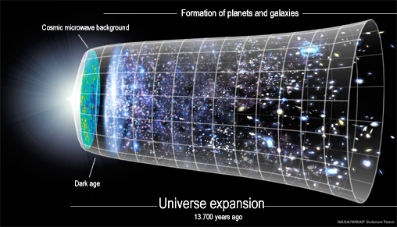
Astronomy: Observation Today
Now we also know that warm, cold and dark matter exist thanks to the measurement of a wide range of wavelengths emitted throughout the Universe.
Even after centuries of astronomical observation, scientists today know little about what the Universe is made up of.
ALMA’s study of cold matter permits the observation of “old” planets and galaxies too faint to be detected by optical telescopes, allowing us to learn about the early Universe.
Cosmic microwave background. Image of the early Universe created by WMAP after 7 years of observation.
Credit: WMAP. License: GNU.
Universe expansion since the Big Bang.
Credit: NASA - WMAP. License: GNU
Notes:
Astronomy: Observation Today
Now we also know that warm, cold and dark matter exist thanks to the measurement of a wide range of wavelengths emitted throughout the Universe.
Even after centuries of astronomical observation, scientists today know little about what the Universe is made up of.
ALMA’s study of cold matter permits the observation of “old” planets and galaxies too faint to be detected by optical telescopes, allowing us to learn about the early Universe.
NOTE: The cosmic microwave background, first detected in 1965 by American physicists Arno Penzias and Robert Woodrow Wilson, is considered the main proof of the Big Bang theory.
It is estimated that only 25% of the Universe is made up of light-emitting matter, or in other words, observable matter.

Slide 10
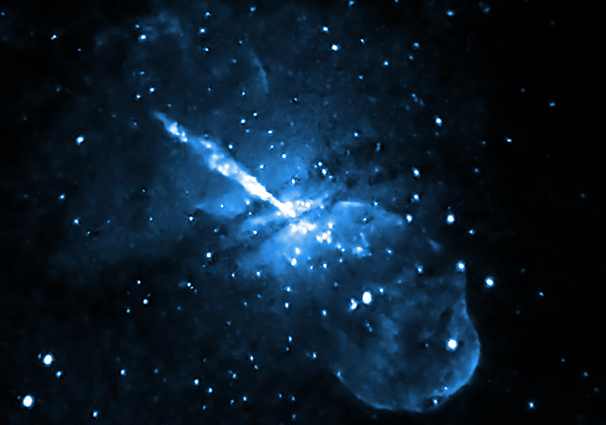
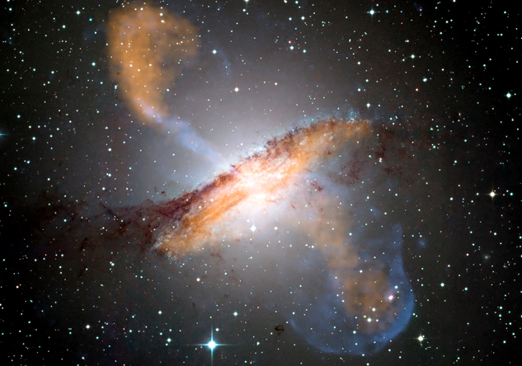
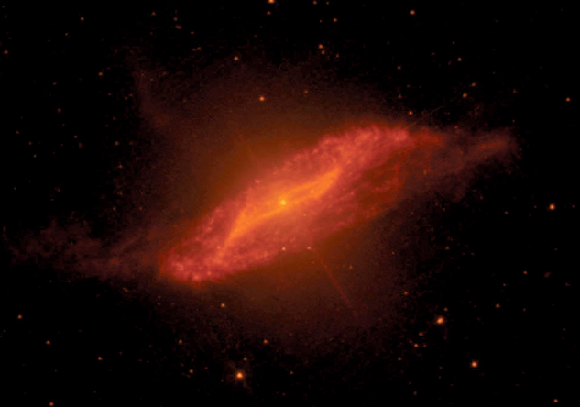
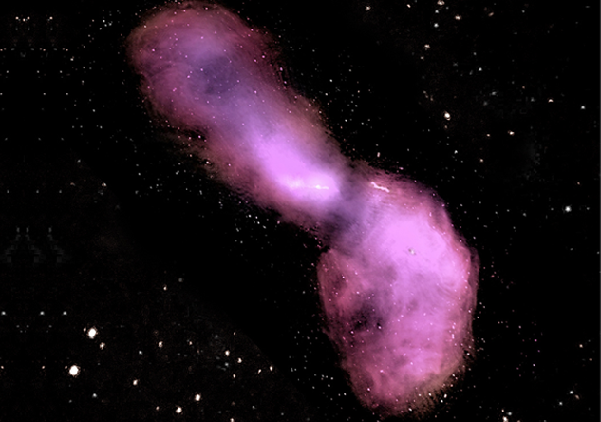
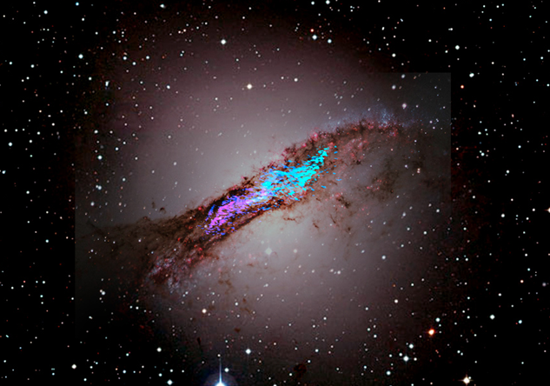
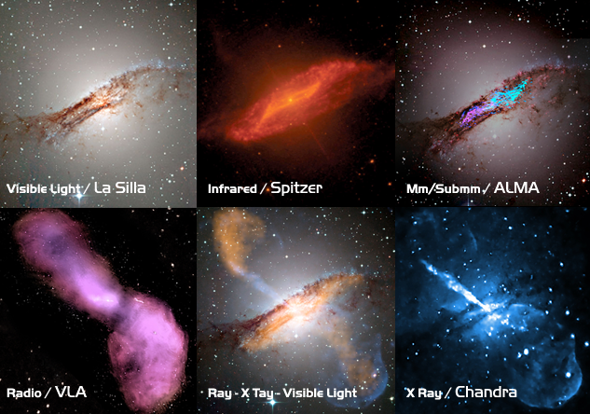
What can we see in the Universe today?
Scientific technological development today allows scientists to design equipment that can capture a wider range of wavelengths.
Optical telescopes, which observe the light of the stars and hot gas emission.
Ultraviolet and X-Ray observatories that study very hot gas and ultra energetic emission.
Infrared light observatories that study warm and hot dust.
Radio telescopes that capture radio emissions from warm and cold matter.
ALMA observes millimetric and submillimetric radio wavelengths.
Views of Centaurus A galaxy in different wavelengths.
View of Centaurus A galaxy view in millimeter and submillimeter radio wavelength from ALMA radio telescope.
Credit: ALMA (ESO/NAOJ/NRAO).
View of Centaurus A galaxy in visible light wavelength from La Silla telescope.
Credit: La Silla observatory.
View of Centaurus A galaxy in X-ray wavelength from Chandra observatory.
Credit: Chandra observatory.
View of Centaurus A galaxy in infrared wavelength from Spitzer observatory.
Credit: Spitzer observatory.
Combined view of Centaurus A galaxy in visible light and X-ray wavelengths.
View of Centaurus A galaxy in radio wavelength from VLA radio telescope.
Credit: VLA radio telescope.
Notes:
What can we see in the Universe today?
Scientific technological development today allows scientists to design equipment that can capture a wider range of wavelengths.
Optical telescopes, which observe the light of the stars and hot gas emission.
Ultraviolet and X-Ray observatories that study very hot gas and ultra energetic emission.
Infrared light observatories that study warm and hot dust.
Radio telescopes that capture radio emissions from warm and cold matter.
ALMA observes millimetric and submillimetric radio wavelengths.

Slide 11
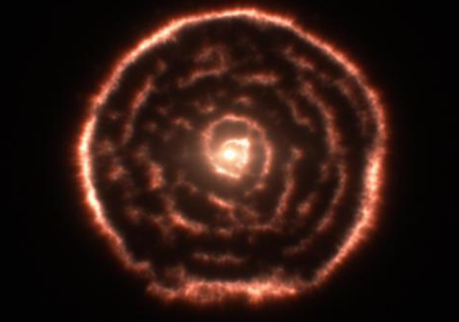
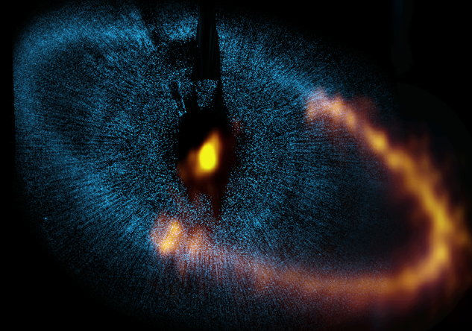
What can ALMA see?
By observing millimetric wavelengths, ALMA can see the so called “Cold Universe”, where plants and galaxies are formed.
ALMA has an unprecedented capability for discovering the presence and distribution of molecules in space and can observe, with high resolution, masses of cold and warm gas around protoplanets.
By observing the "invisible" ALMA can see our sun in detail and capture light emitted by particles rather than light reflected by them.
Thus, ALMA opens up innumerable possibilities for astronomical research, from the discovery of new interstellar molecules to the mysteries of our cosmic origins.
Glycolaldehyde molecules in the gas surrounding the star known as IRAS 16293-2422, 2012.
Credit: ALMA (ESO/NAOJ/NRAO).
Combined view of the dust ring around the bright star Fomalhaut from the ALMA observatory and Hubble telescope, 2012.
Credit: ALMA (ESO/NAOJ/NRAO) / NASA / ESA.
Spiral structure of the material around the old star R Sculptoris revealed by ALMA, 2012.
Credit: ALMA (ESO/NAOJ/NRAO).
Notes:
What can ALMA see?
By observing millimetric wavelengths, ALMA can see the so called “Cold Universe”, where plants and galaxies are formed.
ALMA has an unprecedented capability for discovering the presence and distribution of molecules in space and can observe, with high resolution, masses of cold and warm gas around protoplanets.
By observing the "invisible" ALMA can see our sun in detail and capture light emitted by particles rather than light reflected by them.
Thus, ALMA opens up innumerable possibilities for astronomical research, from the discovery of new interstellar molecules to the mysteries of our cosmic origins.

Slide 12
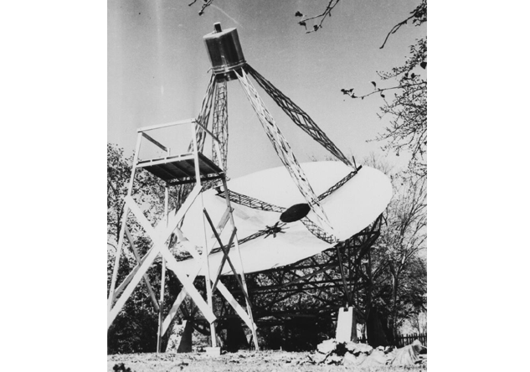
Radioastronomy: A brief history
In 1933, American radio engineer Karl Guthe Jansky proved it was possible to capture certain bands of electromagnetic radiation coming from the Universe with antennas similar to those used in radio transmission.
Later in 1937, Grote Reber, another American engineer, built the first parabolic radio telescope in order to capture and register radio wave signals originating from the Universe.
In 1938 Reber was able to detect radio wave emissions from the Milky Way.
Jansky antenna carrousel, which he designed to capture 20.5-MHz frequency radio waves (a wave length of around 14.5 meters). The antenna is mounted on a rotating platform allowing it to turn in any direction.
Credit: NRAO-Green Bank
The first radio telescope, built by Grote Reber in 1937.
Credit: NRAO-Green Bank.
Notes:
Radioastronomy: A brief history
In 1933, American radio engineer Karl Guthe Jansky proved it was possible to capture certain bands of electromagnetic radiation coming from the Universe with antennas similar to those used in radio transmission.
Later in 1937, Grote Reber, another American engineer, built the first parabolic radio telescope in order to capture and register radio wave signals originating from the Universe.
In 1938 Reber was able to detect radio wave emissions from the Milky Way.
NOTE: Reber’s antenna measured 9.5 meters in diameter, with a focal point located 6 meters above the disc and a radio receptor that amplified and recorded the signals captured.

Slide 13
How does an ALMA antenna work?
Most antennas used in radio astronomy have a reflective surface that is parabolic in shape.
Because of its geometric characteristics a parabolic antenna can efficiently capture signals that reach its surface and direct them to a single point known as the focal point.
The wavelengths concentrated at the focal point are channeled to band receptors located behind the antenna, at the so-called front end, where signals are amplified and digitized so they can be processed.
Detail of an antenna disc at ALMA observatory, 2011.
Credit: ALMA (ESO/NAOJ/NRAO).
Antenna diagram, 2012.
Credit: ALMA (ESO/NAOJ/NRAO).
Notes:
How does an ALMA antenna work?
Most antennas used in radio astronomy have a reflective surface that is parabolic in shape.
Because of its geometric characteristics a parabolic antenna can efficiently capture signals that reach its surface and direct them to a single point known as the focal point.
The wavelengths concentrated at the focal point are channeled to band receptors located behind the antenna, at the so-called front end, where signals are amplified and digitized so they can be processed.
NOTE: The main components of an antenna are:
A parabolic surface or disk made up of metallic panels that can capture radio wavelengths.
The focal point is where the captured signals are concentrated.
Band receptors that are specially designed to capture, amplify and transform the weak wavelengths into electrical signals.
These receptors enable us to access a greater portion of the electromagnetic spectrum because of their unprecedented bandwidth. They work in temperatures in which there is almost no molecular or atomic activity, close to absolute zero or equivalent to -273 degrees Celsius. Such extreme temperatures reduce interference to a minimum, thus permitting optimal superconduction.

Slide 14
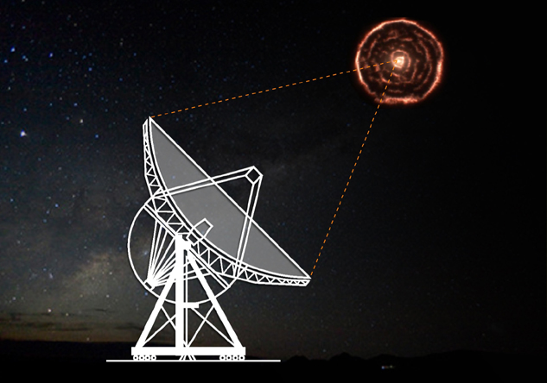
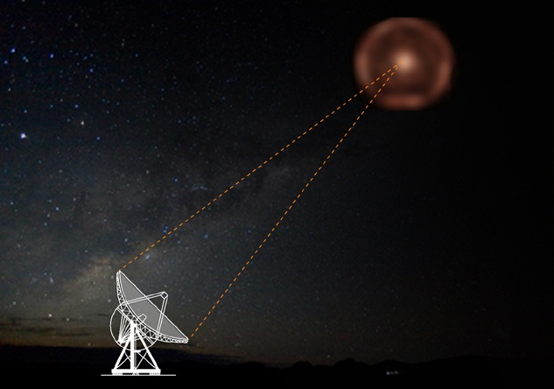
Resolution
A telescope’s capacity to capture details depends on two things;
The diameter of the collecting surface.
The color or wavelength of the light it captures.
The greater the wavelength to be captured, the greater the diameter must be.
In order to observe with the sharpness of the human eye, a radio telescope such as ALMA needs to be at least 500 times wider than the human eye.
The construction of such an enormous antenna, however, is impossible. The scientific community has solved this problem through Interferometry.
A telescope’s resolution depends on the diameter of its collecting surface and the size of the wavelength being captured.
Credit: ALMA (ESO/NAOJ/NRAO).
The resolution depends on the diameter of the collecting surface.
Credit: ALMA (ESO/NAOJ/NRAO).
Notes:
Resolution
A telescope’s capacity to capture details depends on two things;
The diameter of the collecting surface.
The color or wavelength of the light it captures.
The greater the wavelength to be captured, the greater the diameter must be.
In order to observe with the sharpness of the human eye, a radio telescope such as ALMA needs to be at least 500 times wider than the human eye.
The construction of such an enormous antenna, however, is impossible. The scientific community has solved this problem through Interferometry.
NOTE: The Green Bank Telescope (GBT), with a diameter of 100 meters, is the largest mobile telescope today. It is operated by NRAO and is located in West Virginia, USA.

Slide 15
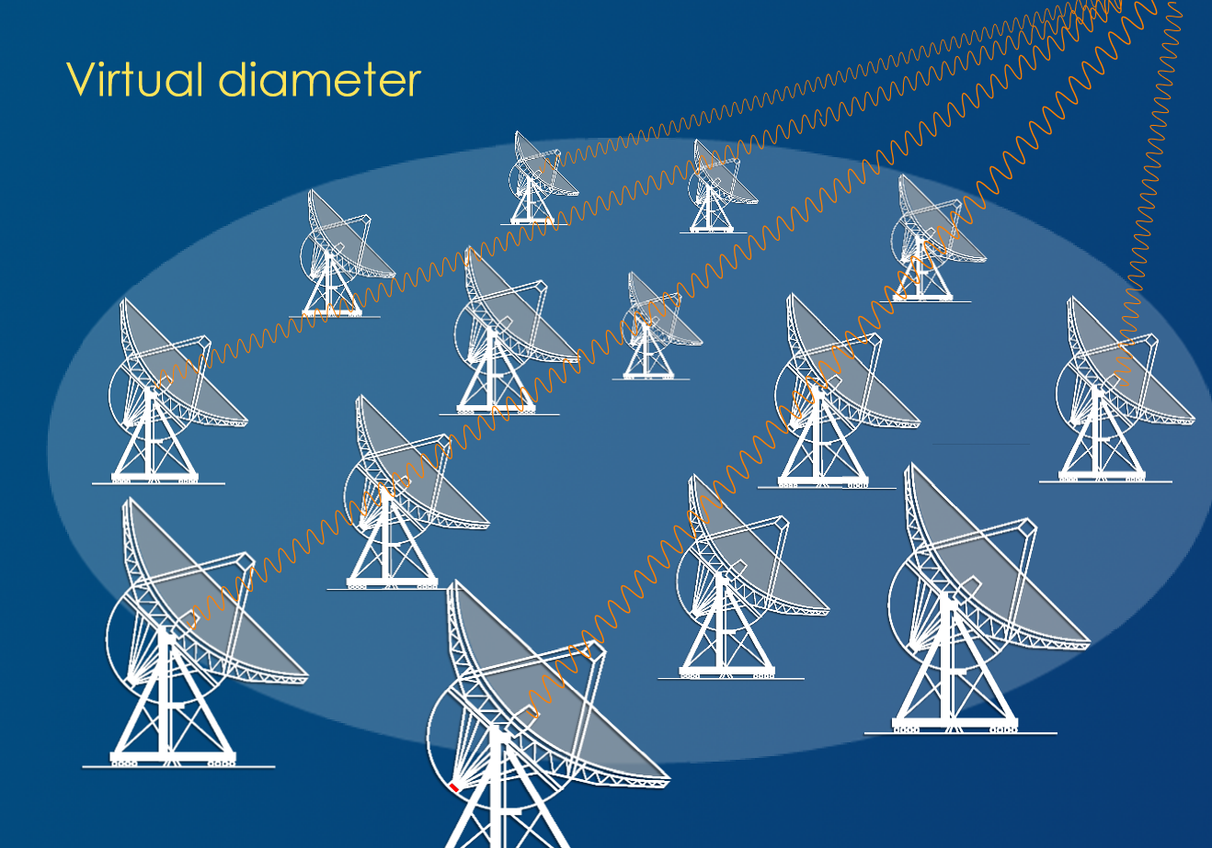
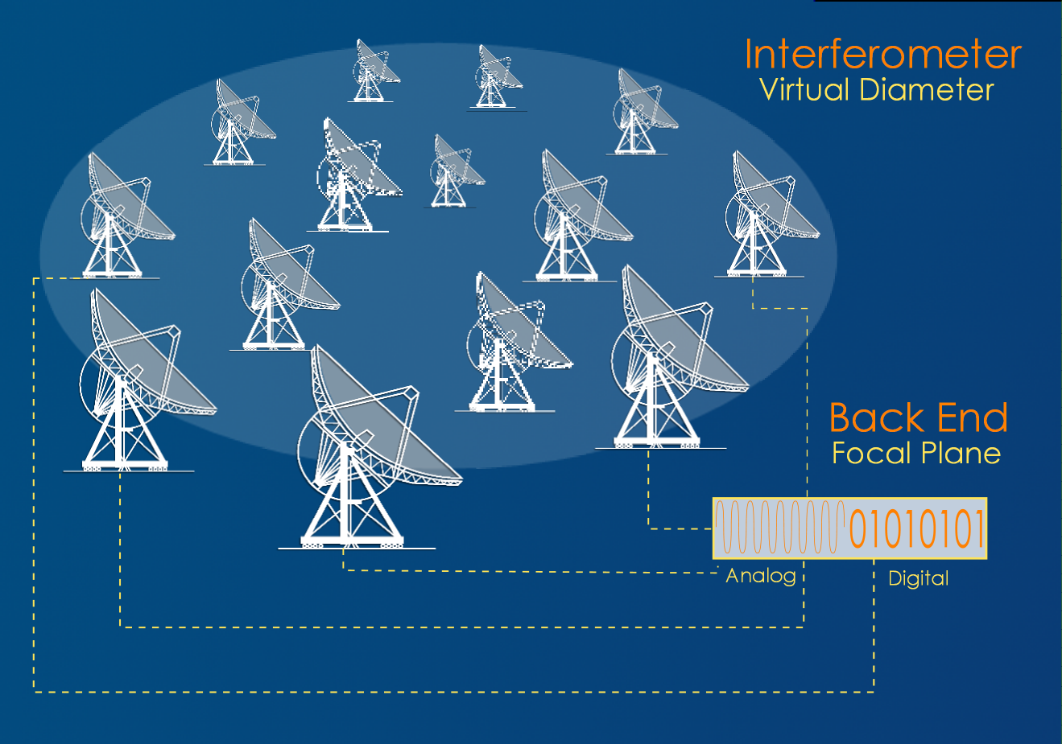
Interferometry
The surface of an antenna is made up of various panels, and the antenna would still work if one of the panels were missing.
It is possible to group together multiple antennas inside a large, defined surface area, where each antenna acts as a panel within this “virtual antenna”.
When a group of antennas is synchronized to observe the same object and the signals captured by each one are then directed, simultaneously, to a single focal plane, an image is obtained that is equivalent in resolution to an image obtained by a single antenna equal in diameter to the group of antennas.
The 66 antennas at ALMA, located on the Chajnantor Plateau, will form a radio interferometer with a maximum diameter of 16 kilometers.
Detail of antenna panels, 2009
Credit: ALMA (ESO/NAOJ/NRAO)
Interferometer diagram, 2012.
Credit: ALMA (ESO/NAOJ/NRAO)
Notes:
Interferometry
The surface of an antenna is made up of various panels, and the antenna would still work if one of the panels were missing.
It is possible to group together multiple antennas inside a large, defined surface area, where each antenna acts as a panel within this “virtual antenna”.
When a group of antennas is synchronized to observe the same object and the signals captured by each one are then directed, simultaneously, to a single focal plane, an image is obtained that is equivalent in resolution to an image obtained by a single antenna equal in diameter to the group of antennas.
The 66 antennas at ALMA, located on the Chajnantor Plateau, will form a radio interferometer with a maximum diameter of 16 kilometers.
NOTE: Once all of its antennas are synchronized, ALMA will be able to capture details with a resolution 10 times greater than the Hubble Space Telescope.

Slide 16
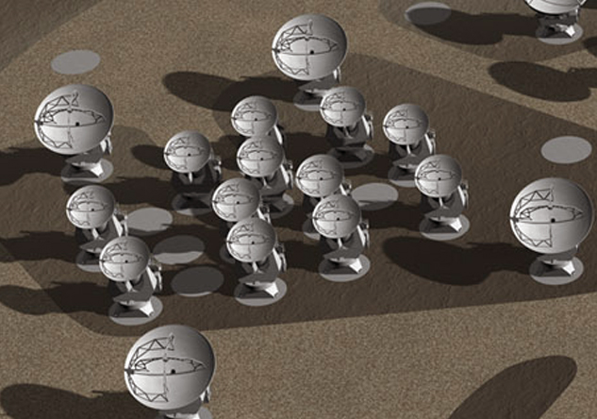
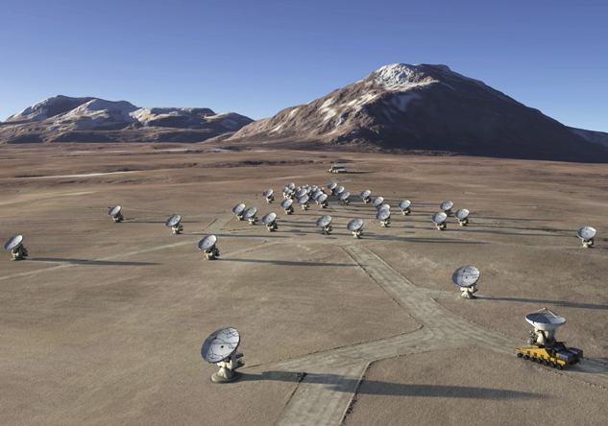
ALMA’s versatility
The technique of Interferometry, invented by the British astronomer Martin Ryle in the 1950s, not only allows for a greater diameter but also enables redistribution of the antennas depending on the resolution required for each observation.
The more details that are needed, the greater the diameter over which the antennas will be distributed for greater resolution.
If greater amplitude is needed, the antennas will be grouped together in smaller-diameter groups, in order to cover larger portions of the sky.
ALMA has two transporters that can move the antennas for the diameter requirements of each observation.
4-antenna group on Chajnantor Plateau.
Credit: ESO.
Artist’s conception of the Atacama Compact Array (ACA).
Credit: ALMA (ESO/NAOJ/NRAO).
Artist’s conception of the extended array of antennas at ALMA.
Credit: ALMA (ESO/NAOJ/NRAO).
Notes:
ALMA’s versatility
The technique of Interferometry, invented by the British astronomer Martin Ryle in the 1950s, not only allows for a greater diameter but also enables redistribution of the antennas depending on the resolution required for each observation.
The more details that are needed, the greater the diameter over which the antennas will be distributed for greater resolution.
If greater amplitude is needed, the antennas will be grouped together in smaller-diameter groups, in order to cover larger portions of the sky.
ALMA has two transporters that can move the antennas for the diameter requirements of each observation.
NOTE: Along with the British radio astronomer Antony Hewish, Martin Ryle was awarded the 1974 Nobel Prize in physics for his role in the discovery of the first pulsar and for developing the “aperture synthesis” technique.
Aperture synthesis is a type of Interferometry that not only creates a virtual telescope on a surface area by using smaller telescopes but also takes advantage of the earth’s rotation to increase the number of angles of observation within a given time lapse.

Slide 17
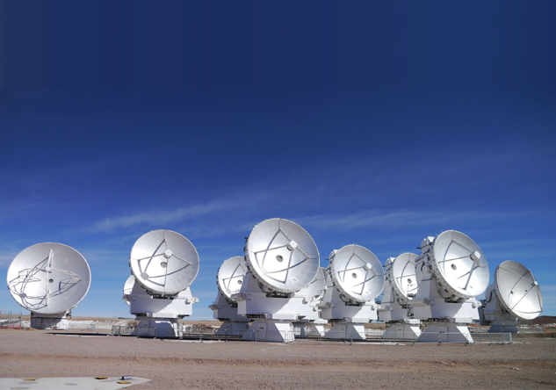
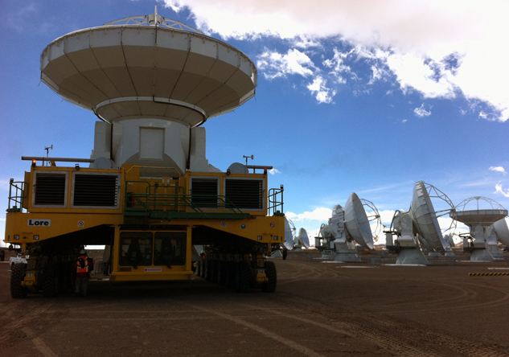
ALMA’s versatility
The transporters, known as Otto and Lore, were specially designed to move the heavy antennas.
ALMA’S group of antennas, which includes 54 major and 12 minor antennas, with diameters of 12 and 7 meters respectively, will adjust to the requirements of the scientific community.
For example, if large portions of the sky are to be observed, then the Atacama Compact Array (ACA), made up of 12 minor and four major antennas, will be used.
ALMA transporters, 2009.
Each transporter has 28 wheels, weighs 130 tons and includes an anti-seismic safety system and an energy generator that enables the cryogenic systems of each antenna to continue working when transported.
Credit: ALMA (ESO/NAOJ/NRAO).
Atacama Compact Array (ACA).
Credit: ALMA (ESO/NAOJ/NRAO). R. Hills.
Notes:
ALMA’s versatility
The transporters, known as Otto and Lore, were specially designed to move the heavy antennas.
ALMA’S group of antennas, which includes 54 major and 12 minor antennas, with diameters of 12 and 7 meters respectively, will adjust to the requirements of the scientific community.
For example, if large portions of the sky are to be observed, then the Atacama Compact Array (ACA), made up of 12 minor and four major antennas, will be used.
NOTE: Each transporter has 28 wheels, weighs 130 tons and includes an anti-seismic safety system and an energy generator that enables the cryogenic systems of each antenna to continue working when transported.

Slide 18
How will ALMA translate wavelengths into images?
Each antenna has a front end, where band receptors convert wavelengths into electrical signals to be sent to the back end, a complex and accurate electronic system where the signals are digitized and synchronized and then sent, via fiber optics, to a central computer known as the Correlator.
ALMA operations diagram.
Credit: ALMA (ESO/NAOJ/NRAO).
Notes:
How will ALMA translate wavelengths into images?
Each antenna has a front end, where band receptors convert wavelengths into electrical signals to be sent to the back end, a complex and accurate electronic system where the signals are digitized and synchronized and then sent, via fiber optics, to a central computer known as the Correlator.

Slide 19
How will ALMA translate wavelengths into images?
The Correlator, ALMA’s central computer, is located in ALMA’s Operations Center on the Chajnantor Plateau. It receives, processes and stores the information sent by the back end.
The Correlator is ALMA’s brain. Here, the data collected by the antennas is processed at a rate of thousands of millions of times per second.
You would need over 3 million laptop computers to carry out the same number of operations per second.
This colossal machine is the world’s most powerful calculator and has been designed especially for ALMA.
The Correlator, ALMA’s central computer, 2009.
Credit: ALMA (ESO/NAOJ/NRAO), S. Argandoña.
Notes:
How will ALMA translate wavelengths into images?
The Correlator, ALMA’s central computer, is located in ALMA’s Operations Center on the Chajnantor Plateau. It receives, processes and stores the information sent by the back end.
The Correlator is ALMA’s brain. Here, the data collected by the antennas is processed at a rate of thousands of millions of times per second.
You would need over 3 million laptop computers to carry out the same number of operations per second.
This colossal machine is the world’s most powerful calculator and has been designed especially for ALMA.

Slide 20
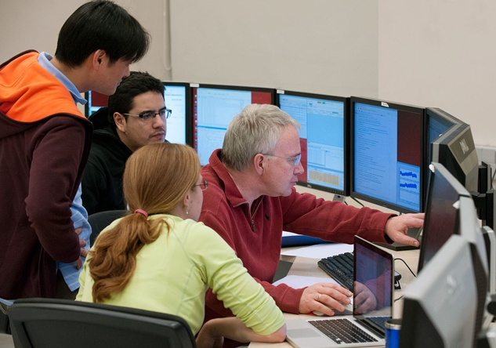
How can we observe through ALMA?
Each year scientists compete for observation time by presenting proposals that are evaluated on the basis of scientific merit.
Priority will be given to projects from the countries that finance ALMA: North America (USA and Canada), East Asia (Japan and Taiwan), 14 European countries and Brazil. Chile, as the host nation, is entitled to 10% of the overall observation time.
Those astronomers whose proposals are admitted don’t have to travel to ALMA to carry out observations; instead, they will have remote and exclusive access to the data gathered.
ALMA has an exclusive software structure that allows astronomers to do many things, from generating the astronomical project to receiving the data for the observational proposal.
Control room at ALMA’s Operations Center (OSF), 2010.
Credit: ALMA (ESO/NAOJ/NRAO)
Scientists examining ALMA data.
Credit: NAOJ
Notes:
How can we observe through ALMA?
Each year scientists compete for observation time by presenting proposals that are evaluated on the basis of scientific merit.
Priority will be given to projects from the countries that finance ALMA: North America (USA and Canada), East Asia (Japan and Taiwan), 14 European countries and Brazil. Chile, as the host nation, is entitled to 10% of the overall observation time.
Those astronomers whose proposals are admitted don’t have to travel to ALMA to carry out observations; instead, they will have remote and exclusive access to the data gathered.
ALMA has an exclusive software structure that allows astronomers to do many things, from generating the astronomical project to receiving the data for the observational proposal.
NOTE: ALMA has two kinds of software to enable astronomers to prepare and process their observations: 1. The ALMA Observing Tool or ALMA-OT, created by ALMA to prepare and carry out observations. 2. The Common Astronomy Software Applications (CASA) for processing and reducing the data obtained from observation.

Slide 21
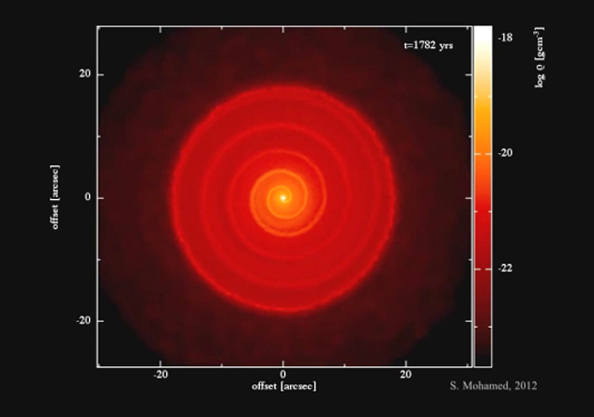
How can we observe through ALMA?
After a period of one year, the collected data will be made public in an astronomical library that, while reaching full capacity, will grow at a rate of 700 gigabytes per day.
This library will constitute a veritable treasure trove of information at the disposal of all mankind, representing a central source of future discoveries.
Ethylic cyanide molecule (CH3CH2CN) radio emission pattern in various frequencies, 2012.
Credit: Fortman, et al., NRAO/AUI/NSF, NASA.
Simulation of material surrounding the old star R Sculptoris, 2012.
Credit: ESO/S. Mohamed.
Notes:
How can we observe through ALMA?
After a period of one year, the collected data will be made public in an astronomical library that, while reaching full capacity, will grow at a rate of 700 gigabytes per day.
This library will constitute a veritable treasure trove of information at the disposal of all mankind, representing a central source of future discoveries.

Slide 22
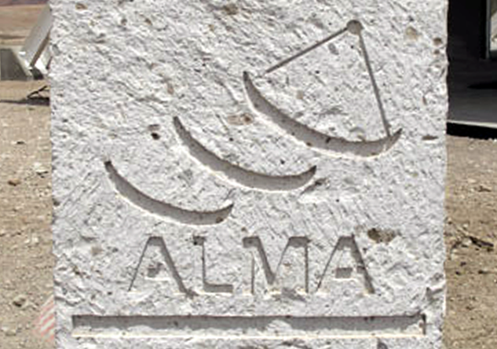
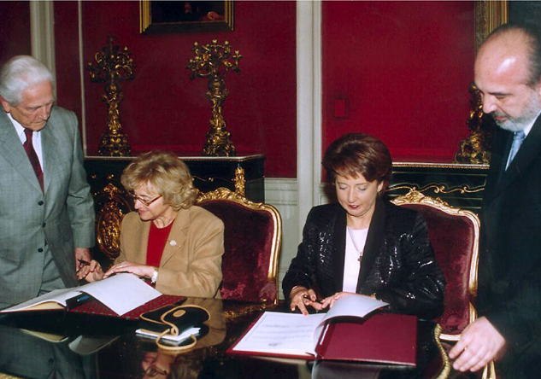
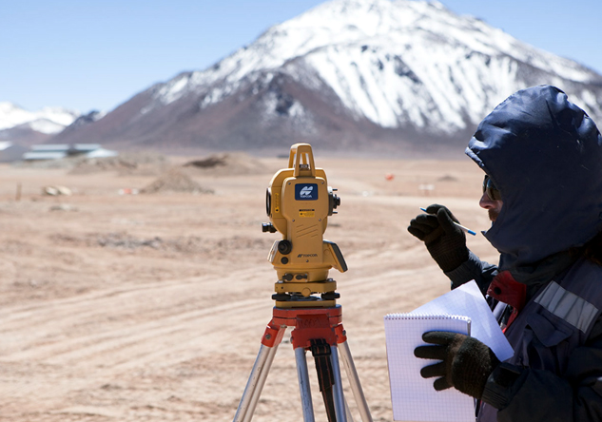
The History of ALMA
In the 1980s the international scientific community developed an interest in creating a radio telescope that could capture, at high resolutions, millimetric and sub-millimetric radio bands.
In 1995 the European Organization for Astronomical Research in the Southern Hemisphere (ESO), the National Radio Astronomy Observatory (NRAO) of the United States and the National Astronomical Observatory of Japan (NAOJ) began to carry out atmospheric trials in the Atacama desert.
Four years later, in 1999, the three observatories signed a cooperation agreement to install ALMA in Chile.
Another six years passed and in October 2005, the foundations were laid on the Chajnantor Plateau, initiating construction of the ALMA observatory.
Testing at the Chajnantor plateau, 2002.
Credit: ALMA (ESO/NAOJ/NRAO), NAOJ.
Monolith at Chajnantor.
Credit: ALMA (ESO/NAOJ/NRAO), NAOJ.
Signing the agreement between ALMA and the Chilean government, 1999.
Credit: ALMA (ESO/NAOJ/NRAO)
Testing at the Chajnantor Plateau.
Credit: ALMA (ESO/NAOJ/NRAO), NAOJ.
Notes:
The History of ALMA
In the 1980s the international scientific community developed an interest in creating a radio telescope that could capture, at high resolutions, millimetric and sub-millimetric radio bands.
In 1995 the European Organization for Astronomical Research in the Southern Hemisphere (ESO), the National Radio Astronomy Observatory (NRAO) of the United States and the National Astronomical Observatory of Japan (NAOJ) began to carry out atmospheric trials in the Atacama desert.
Four years later, in 1999, the three observatories signed a cooperation agreement to install ALMA in Chile.
Another six years passed and in October 2005, the foundations were laid on the Chajnantor Plateau, initiating construction of the ALMA observatory.

Slide 23
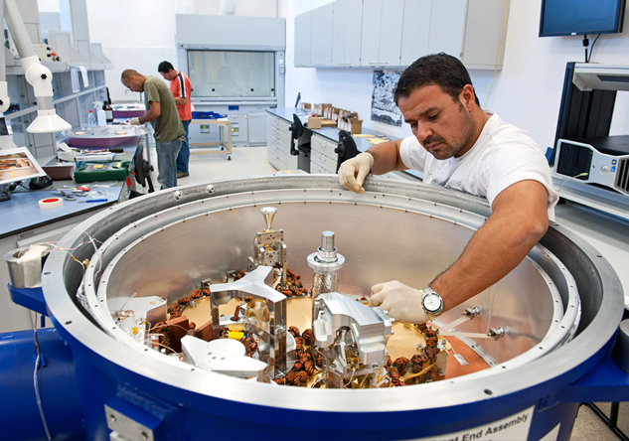
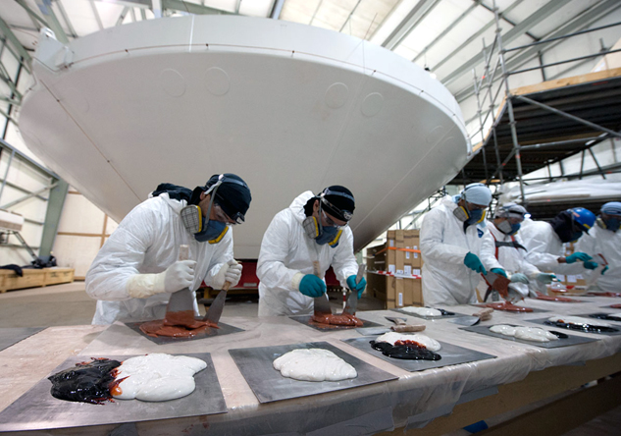
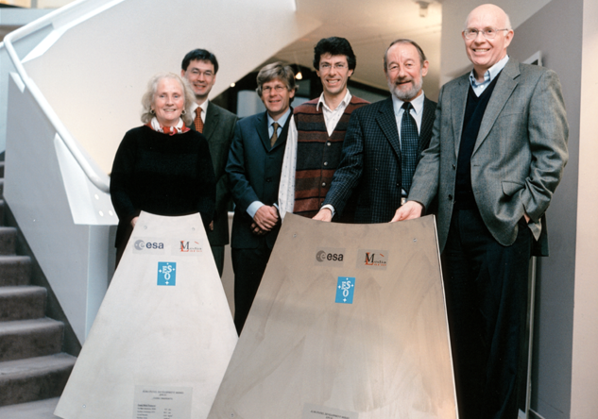
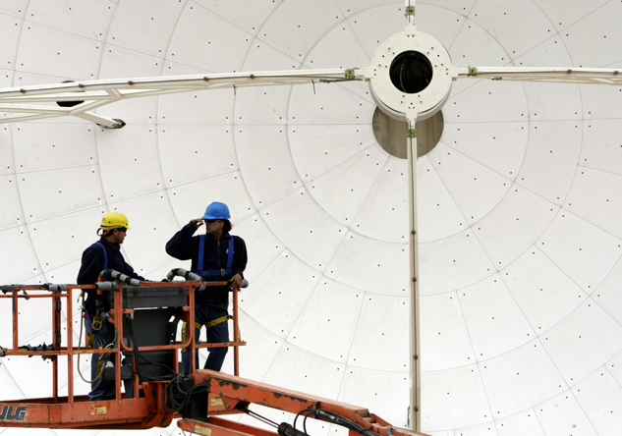
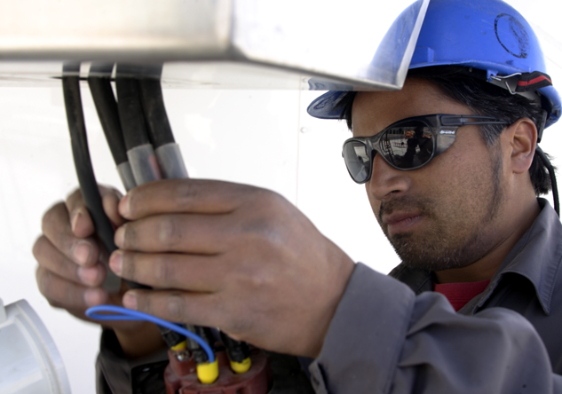
The soul of ALMA
The people who work at ALMA represent more than 20 nationalities and the most diverse cultures, languages and professions.
In addition, there are thousands of people from distant universities, institutes, laboratories and companies who collaborate to make the world’s largest and most powerful radio astronomy telescope a reality.
Everyone contributes scientific experience, new designs and groundbreaking technological developments.
Working with ALMA components at the Rutherford Appleton Laboratory in the United Kingdom, 2004.
Credit: ALMA (ESO/NAOJ/NRAO), H. Zodet, ESO.
ALMA staff, 2009.
Credit: ALMA (ESO/NAOJ/NRAO), C. Padilla.
ALMA staff, 2009.
Credit: ALMA (ESO/NAOJ/NRAO), C. Padilla.
The ALMA team at the central offices of ESO in Garching, Germany, 2011.
Credit: ALMA (ESO/NAOJ/NRAO), ESO.
Cryo-preparation of glue.
Credit: ESO/Max Alexander
Patricio Escarate, Vacuum and Cryogenics Technician.
Credit: ESO/Max Alexander
Notes:
The soul of ALMA
The people who work at ALMA represent more than 20 nationalities and the most diverse cultures, languages and professions.
In addition, there are thousands of people from distant universities, institutes, laboratories and companies who collaborate to make the world’s largest and most powerful radio astronomy telescope a reality.
Everyone contributes scientific experience, new designs and groundbreaking technological developments.

Slide 24
When will ALMA be fully operational?
By the end of 2013 ALMA’s 66 antennas will be fully operational.
This will mean a huge leap forward in astronomical terms, since ALMA will have a sensitivity and spectral resolution 100 times greater sensibility than its predecessors in millimeter and sub-millimeter waves.
As has happened with the great telescopes that have preceded it, ALMA will allow us to see things in the Universe of which we aren't yet aware.
Group of antennas at Chajnantor Plateau, 2011.
Credit: ALMA (ESO/NAOJ/NRAO), J. Guarda.
Notes:
When will ALMA be fully operational?
By the end of 2013 ALMA’s 66 antennas will be fully operational.
This will mean a huge leap forward in astronomical terms, since ALMA will have a sensitivity and spectral resolution 100 times greater sensibility than its predecessors in millimeter and sub-millimeter waves.
As has happened with the great telescopes that have preceded it, ALMA will allow us to see things in the Universe of which we aren't yet aware.

